Slide 1

Mobile Application for Marginalized Communities
MobiTel

Slide 2
Luminus Solutions
Team Member | Primary Role | Secondary Role
NONHLANHLA MABUZA | SCRUM MASTER | TESTER
ASHLEY GARDNER | ANALYST | DESIGNER
NICOLAN REDDY | ANALYST | TESTER
LWANDO SOBEKWA | DESIGNER | ANALYST
SINAKO CETYIWE | DESIGNER | QUALITY ASSURER
SHANA-MICHELLE RABONDA | IMPLEMENTER | DESIGNER/PROJECT MANAGER

Slide 3
Brief Outline
Nonhlanhla Mabuza
Personality Preferences
Team Contract
WBS
Ashley Gardner
Requirements
Stakeholders

Slide 4
Nicolan Reddy
Context Diagram
Business Flow
Sinako Cetyiwe
HCI considerations
Navigation
Testing

Slide 5
Shana Rabonda
DEMO
Nonhlanhla Mabuza
Risk
Challenges
Lessons learned

Slide 6
Personality Preferences
Name | Myers Briggs Typology Test | Reality
Ashley | ESFJ | INTJ
Lwando | ENTJ | ISTJ
Nicolan | INFJ | INFJ
Nonhlanhla | ENTJ | ENTJ
Shana-Michelle | ISFJ | INFJ
Sinako | ESTP | ENFP

Slide 7
Team Contracts
Code of Conduct
Communication
Problem- Solving
Participation
Meeting guidelines

Slide 8
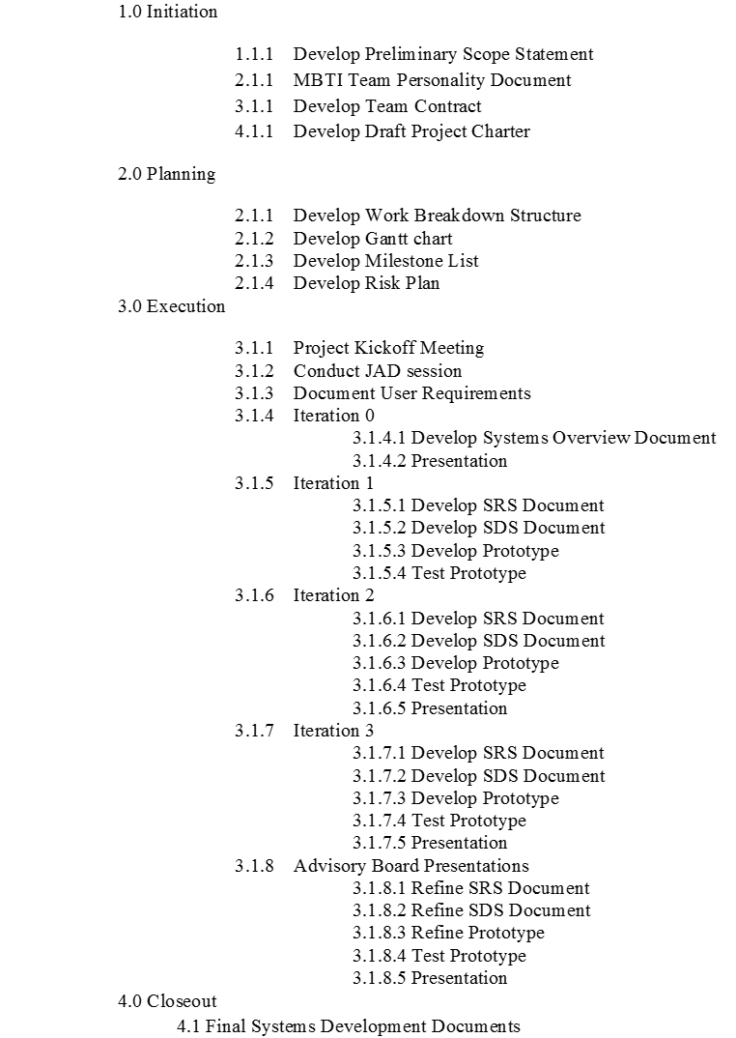

Work Breakdown Structure
Develop SRS Document
Test prototype
Develop prototype
Develop SDS Document

Slide 9
Key Changes to WBS
Scope Definition
HCI Considerations
Language Translations

Slide 10
Requirements
Functional | Non-Functional
Develop a front-end mobile application that runs on an Android Operating System. | Robust, high performance and sustainable mobile application.
Use the front-end mobile app to upload/modify descriptions, pictures and prices of their guest accommodation. | Reliable, cost effective and easy to use.
User must be registered on TeleWeaver. | Comply with Android Rules and Standards.
A language package that enables users to change the language between English and isiXhosa.
Payment settlements will happen when the service is rendered.
Must be developed using Basic For Android.
Must be compatible with Android 2.3 to 2.3.2 Gingerbread Operating System.
Notes:
Functional Requirements:
Functional Requirements define specific behaviour or functions.
Non-Functional Requirements:
Non-functional requirements specify criteria that can be used to judge the operation of a system, rather than specific behaviours.

Slide 11
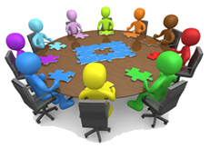
Stakeholders
Reed House Systems
Siyakhula Living Lab
Dwesa Community
KwaWendy’s Homestay

Slide 12
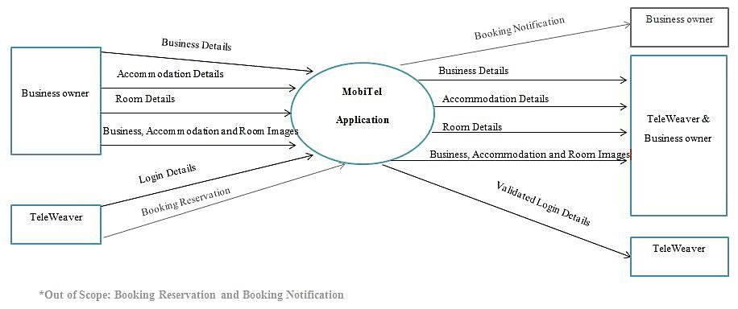
Context Diagram (MobiTel)

Slide 13
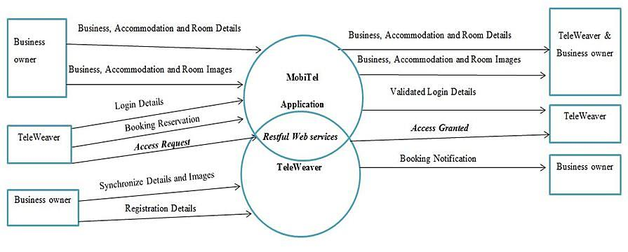
Context Diagram (TeleWeaver)

Slide 14










Business Flow
2. Stores Business Owner’s Profile
Abstraction Layer
9. Uploads Business Information
TeleWeaver
1. Registers
3. Registration Details
Restful Services
TeleWeaver Database
Connects Via Wi-Fi
TeleWeaver designated access node
Reed House Systems Website
4. Download App
10. Logs on to
11. Business Owner’s Contact Details
6. Validates Login
5. Logs in
8. Synchronisation
7. Business Information
Business Owner
MobiTel Application
Potential Guest
12. Liaise

Slide 15
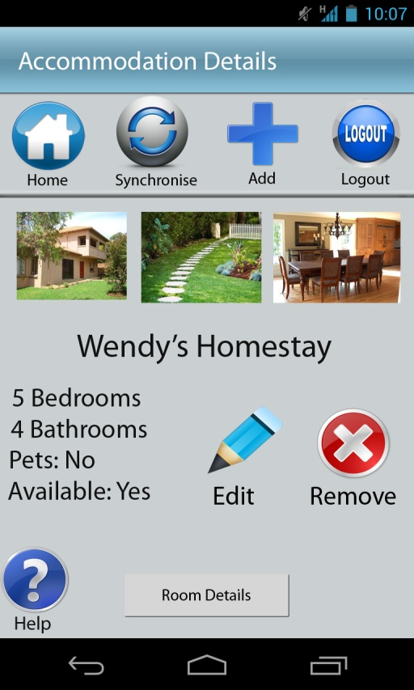
Design Considerations
Goals:
Usability
Learnability, Efficiency, Memorability, Errors, Satisfaction
User Control and Freedom- clearly marked exits
Error Prevention – minimised error-prone conditions
Validations
Size of icons
Recognition v. recall – objects/actions/actions visible
User-friendliness
Aesthetics
Minimalistic design
Symmetry
Contrast

Slide 16
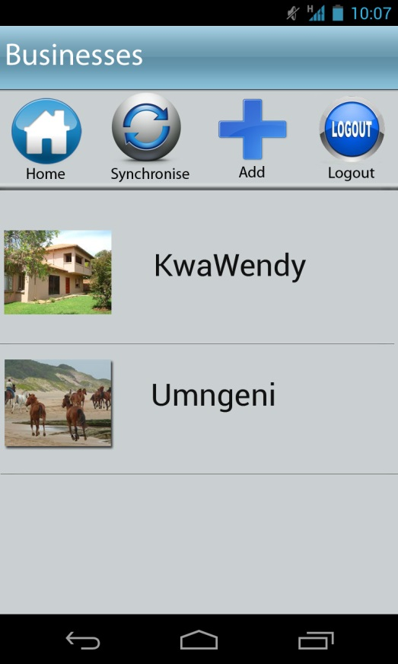
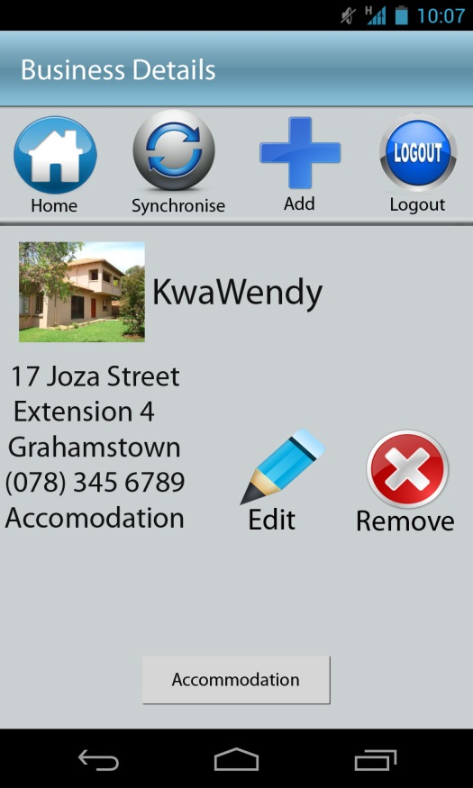
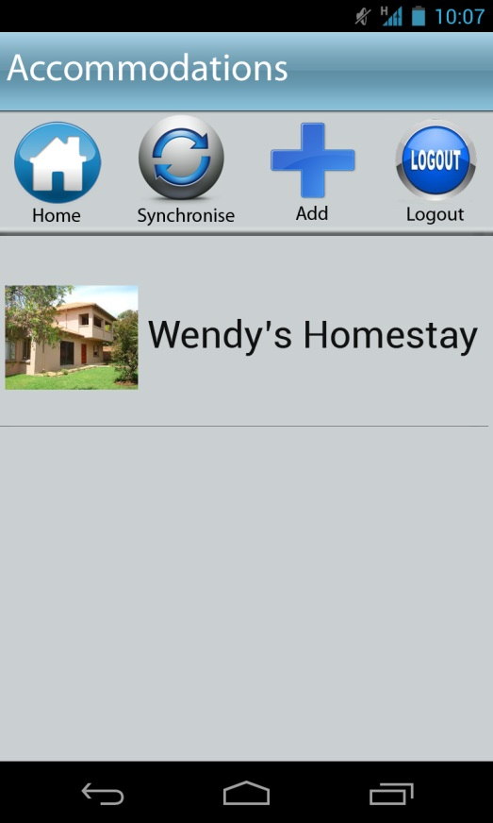
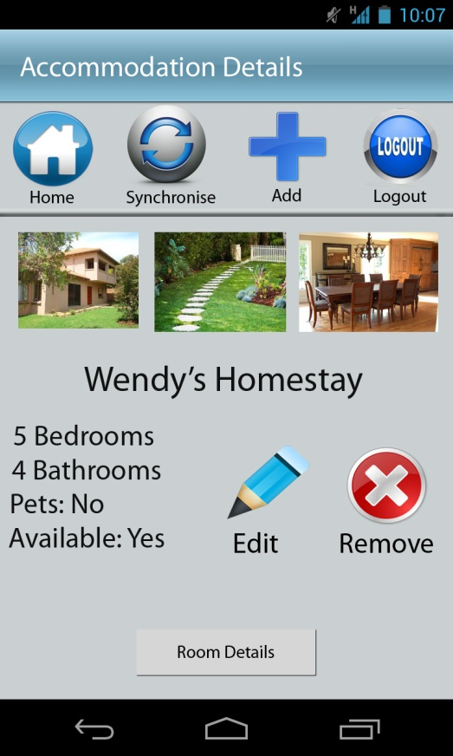
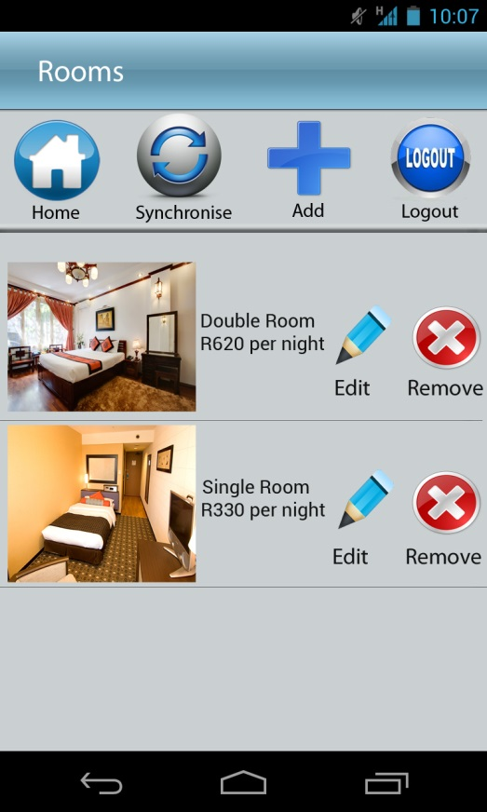
General Navigation

Slide 17
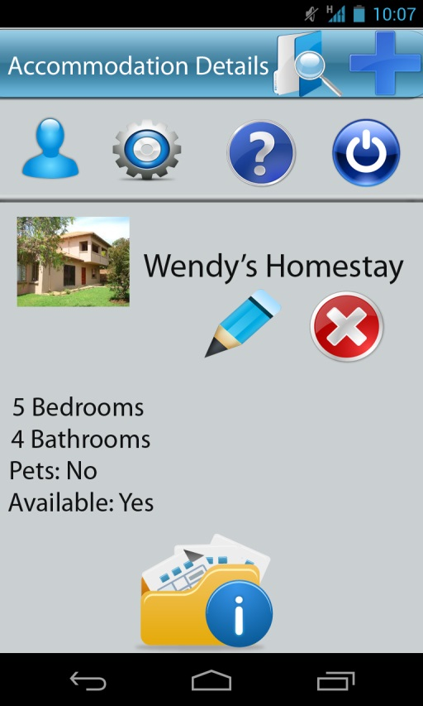
Testing
User Testing
Representative Users Changes to UI design
Labeled icons
Icon replacement
Changes to icon placement
Introduction of IsiXhosa
QA Testing
Changes to Program design
Home icon introduction
Removal of the search function
Introduction of the help function

Slide 18


Slide 19
Perceived Risk Matrix
Risk | Potential Response | Impact
Failure to integrate with TeleWeaver | Agreement with Project Sponsor | Medium
Client Dissatisfaction | Management of expectations & open communication | Medium
Language Barrier | Training | Medium
Loss of Data | Communication within the team | High
Scope Definition | Numerous meetings with various stakeholders | Medium

Slide 20
Actual Risk Matrix
Risk | Response | Impact
Misinterpreting user requirements & Scope definition | Agreement with Project Stakeholders | High
Team Dynamics | Open Communication | Medium
Failure to integrate with TeleWeaver | Constant communication and working together | Medium
Loss of Data | Communication within the team and version control | High

Slide 21
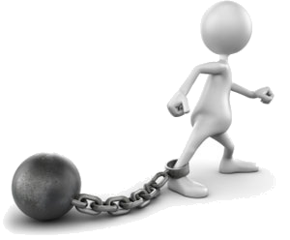
Challenges
Language Localization
Memory
Few reference points for solutions
Availability of Project sponsor
Integration with the back end

Slide 22
Lessons Learned
Understand user requirements
Engage the clients at all stages
Communication is vital
Time management
Workload allocation

Slide 23


